Slide 1
Machine Learning
Notes:
Machine Learning

Slide 2
Introduction to Machine Learning
Notes:
Let us start with the introduction to Machine Learning.

Slide 3

Analyze the distinctions and applications of machine learning, deep learning, and artificial intelligence through real-world examples for various technical applications
Differentiate among various machine learning models and explore how each model learns from data to predict outcomes
Explore Python libraries for effective data manipulation, visualization, and implementation of machine learning algorithms
Notes:
Read the objectives

Slide 4
Business Scenario
ABC Inc., an e-commerce company, is struggling with a surge in fraudulent transactions on its website. The manual review process for transactions has caused delays in order processing and led to a negative customer experience.
To address this, ABC Inc. will use machine learning algorithms to detect real-time fraudulent transactions. These algorithms will be integrated into ABC Inc.'s existing transaction processing system to flag suspicious transactions and prevent fraud.
Additionally, the company will use machine learning algorithms to predict customer behavior based on past purchase history, thereby improving the recommendation engine’s performance. With machine learning, ABC Inc. can provide a more personalized customer experience, streamline order processing, and increase sales.
Notes:
Elaborate each sentences.

Slide 5
What Is Machine Learning?
Notes:
Instructor Notes:
In this topic, we are going to get introduced to the what is Machine Learning.

Slide 6

Machine Learning
It is a subset of artificial intelligence (AI) that assists systems to learn and improve automatically from experience without being explicitly programmed.
Arthur Samuel coined the term machine learning (ML) in 1959.
It enables programs to learn automatically, making computers more intelligent without human intervention.
Notes:
Instructor Notes:
What is machine learning? In 1959, Arthur Samuel coined the term machine learning ML. Machine learning is a branch of artificial intelligence (AI) and computer science which focuses on the use of data and algorithms to imitate the way that humans learn, gradually improving its accuracy. The term refers to the ability of a machine to learn from and replicate human behavior. The main aim of ML is to allow programs to learn automatically and make computers more intelligent without any human intervention, even if there are minor variations. Although ML has existed for a long time, it's adoption has accelerated in recent times.

Slide 7
Traditional Approach Vs Machine Learning Approach
Traditional approach | Machine learning approach
Uses predefined rules and algorithms explicitly programmed by human developers | Learns from data to make predictions or take actions without being explicitly programmed
Relies on explicitly defined logic and rules to perform tasks | Uses statistical techniques and optimization algorithms to learn patterns and make decisions
Requires manual feature engineering, where relevant features must be identified and extracted by human experts | Automatically learns features from raw data, reducing the need for manual feature engineering
Faces challenges in handling complex and unstructured data without significant preprocessing | Handles complex and unstructured data, such as images, text, and audio, without requiring extensive preprocessing
Performance depends on the accuracy and completeness of the predefined rules and algorithms | Performance improves with more data and learning iterations, enhancing accuracy and generalization
Notes:
Instructor Notes:
Traditional Approach | Machine Learning Approach
Rules-based: Developers manually define a set of rules and instructions. | 1. Data-driven: Models learn from data patterns and relationships.
Explicitly coded: Each step of the program's logic is written in a programming language. | 2. Trained: Models go through a training phase with a large dataset.
Fixed logic: Program behavior remains constant, regardless of input or context. | 3. Generalization: Models adapt and respond to different inputs and contexts.
Human intuition and domain knowledge are essential for rule creation. | 4. Performance evaluation: Models are assessed based on accuracy, precision, recall, etc.
Limited ability to handle complex or ambiguous problems. | 5. Can handle complex problems by extracting patterns from data.

Slide 8
Difference Between ML, DL, and AI
Machine learning (ML), deep learning (DL), and artificial intelligence (AI) are often used interchangeably.
Artificial intelligence
It encompasses the simulation of human intelligence
in machines.
Example: Self-driving cars
Machine learning
It is a subset of AI, which focuses on algorithms that enable computers to learn from data.
Example: Amazon Alexa
Deep learning
It is a subset of ML that uses neural networks with multiple layers for complex pattern recognition, such as recognizing patterns in images, speech, and text.
Example: Handwriting recognition
Notes:
Instructor Notes:
Machine Learning (ML), Deep Learning (DL), and Artificial Intelligence (AI)
Artificial Intelligence (AI):
Encompasses the simulation of human intelligence in machines.
Example: Self-driving cars.
Machine Learning (ML):
A subset of AI focused on algorithms that enable computers to learn from data.
Example: Amazon Alexa.
Deep Learning (DL):
A subset of ML that uses neural networks with multiple layers for complex pattern recognition.
Example: Image recognition.

Slide 9
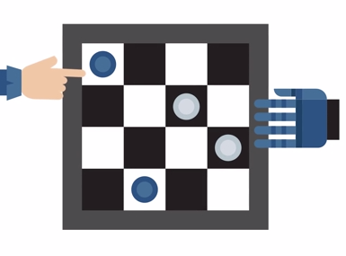
Machine Learning: Example
In a chess game between a computer and a person, the computer uses AI to analyze the game, predict moves, and decide its actions.
The AI uses machine learning to figure out if the opponent is a beginner, intermediate, or advanced player.
The AI decides its next move against the opponent using a complex neural network that learns various features and patterns from the data.
Notes:
Instructor Notes:
In a scenario where a computer competes against a human player in a chess game, the computer employs artificial intelligence techniques to comprehend the game dynamics, anticipate possible moves, and strategize its own moves accordingly. This illustrates how AI enhances gaming experiences by simulating human-like decision-making processes.

Slide 10




Applications of Machine Learning
There are many applications for machine learning, including the following:
Spam filtering
Sentiment analysis
Social media analysis
Online recommendation systems
Customer service chatbots
Notes:
Instructor Notes:
Various applications of Machine learning include:
Sentiment analysis
Spam Filtering
Social media analysis
Customer service chatbots
Online recommendation systems

Slide 11



Machine Learning Algorithms
These processes allow computers to learn patterns from data and make predictions on their own.
Machine learning algorithms help applications to:
Predict outcomes
Classify the target feature
Improve the performance
Notes:
Instructor Notes:
What are algorithms?
Algorithms are nothing but a set of instructions used to solve problems. ML Algorithms help predict, classify and improve the performance of any software application.

Slide 12
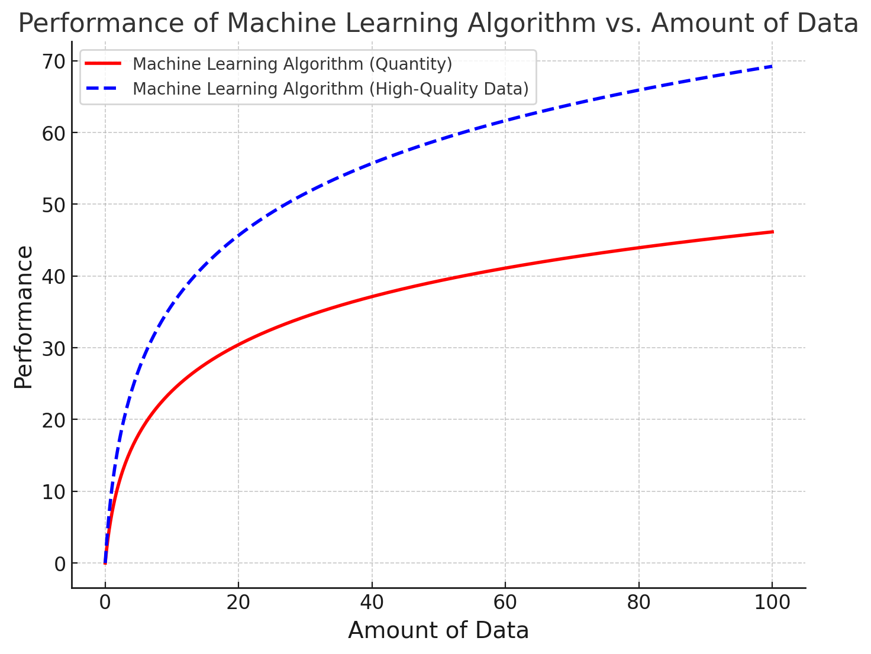
Data and Machine Learning Algorithms
The quality and quantity of the provided data evaluate the algorithm's performance.
High-quality and quantity of data is crucial for machine learning as it ensure better predictions and insights.
Source: https://academic.oup.com/nsr/article/10/7/nwad125/7147579
Notes:
Instructor Notes:
ML models encounter the issue of the mismatch between a high dimension of feature space and small sample size (for traditional ML models) or the mismatch between model parameters and sample size (for deep-learning models), usually resulting in terrible performance.

Slide 13
Types of Machine Learning
Notes:
Types of machine learning.

Slide 14
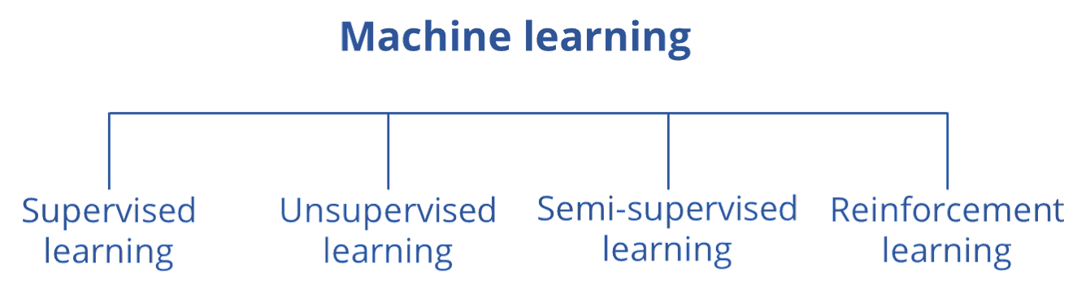
Types of Machine Learning
ML can be divided into four main categories; each characterized by its capacity to predict conditions or identify patterns to produce outcomes.
Notes:
Instructor Notes:
There are different types of Machine learning, depending on whether the algorithm can self train and predict a condition or needs to identify patterns to derive outcomes.
It can be divided into four main categories.
Supervised learning
Unsupervised learning
Semi-supervised
Reinforcement learning.

Slide 15
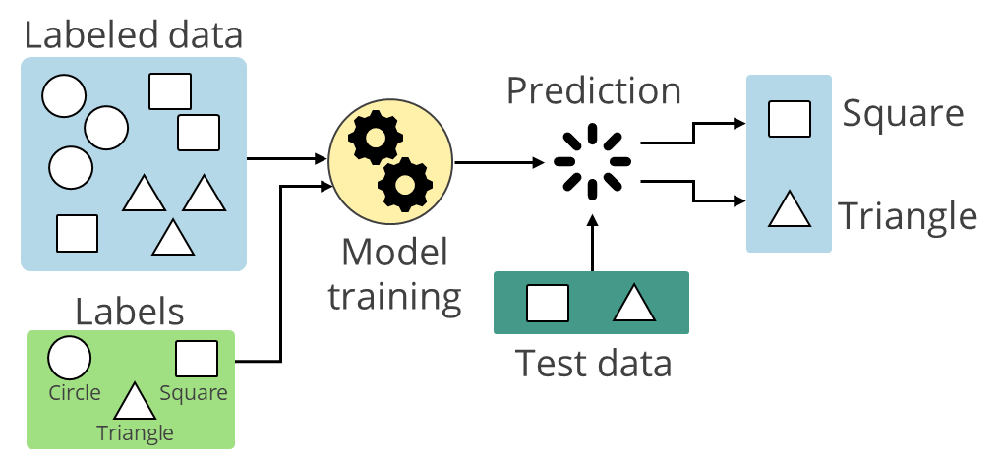
Supervised Learning
A supervised learning method uses labeled data to predict outcomes guided by specific input-output pairs.
Here, both inputs and outputs are known.
Notes:
Instructor Notes:
Supervised learning is the most widely used form of machine learning. The computer learns to make predictions based on a set of labeled data.
Labeled data is raw data that has been assigned labels or tags to add context or meaning, which is used to train machine learning models in supervised learning.
Supervised learning, as the name suggests, mimics a work environment where the algorithm uses the data developed in supervised environments to deliver an output. Here inputs and outputs are known.
This can be compared to a workplace scenario where a new employee learns about specific outcomes validated by his supervisor in the presence of the supervisor.
Explanation for labeled data?
Data containing meaningful tags that set the context for the data. Example: An image with a label says Dog or cat. Labeled data is used to train supervised machine learning models, to make predictions.
Example: A supervised learning method could train a machine to classify images of apples, mangoes, and pears.

Slide 16
Supervised Learning Algorithms
Some commonly known supervised learning algorithms are:
Linear regression
Decision trees
Logistic regression
Support vector machines
Notes:
Instructor Notes:
Some commonly known supervised learning algorithms are linear regression logistic regression, support vector machines, decision trees, etc.

Slide 17



Supervised Learning: Examples
Some examples of supervised learning are:
Predicting temperature rise based on yearly
temperature trends
Predicting crop yield based
on seasonal crop
quality changes
Sorting waste based on known waste items and their corresponding waste types
In spam filtering, computers learn from labeled emails to decide if new emails are spam or not.
Notes:
Instructor Notes:
Examples of supervised learning are:
Prediction of temperature increase when year wise temperature increase is known.
Prediction of crop yield when season wise crop quality deterioration is known.
Classification of waste when the waste items, input and the type of waste are known.
Further supervised learning helps in two tasks, namely classification and regression used for prediction of continuous and discrete values. One example of Classification task is Spam filtering where computer learns from labeled emails to decide if new emails are spam or ham(discrete value as output)

Slide 18
Unsupervised Learning
It allows models to identify patterns and structures in unlabeled data without explicit guidance.
Some examples are:
Image segmentation for object detection
Identification of user groups based on commonalities
Identification of anomalies over geographical landscapes based on the data patterns
The unlabeled dataset is provided to an unsupervised learning algorithm to discover hidden patterns and recognize their relationship.
Notes:
Instructor Notes:
Unsupervised learning. In this learning, no supervisor is required to prepare data as outputs may not be known for such algorithms. The program needs to find hidden patterns and recognize their relation.
Examples of unsupervised learning are:
Identification of anomalies over geographical landscapes based on the data patterns.
Identification and grouping of crop rot
Identification of user groups based on commonalities.
**Explanation for unlabeled data?
Unlabeled data lacks explicit tags or annotations defining the context of the data. It does not contain predefined labels indicating specific categories or classes.

Slide 19
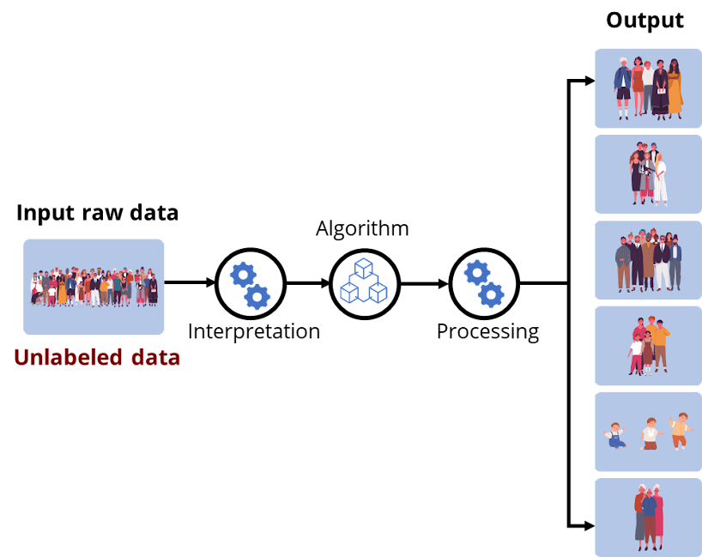
Unsupervised Learning: Example
It automatically groups images into distinct categories based on similarities, such as age group or gender, without any prior labels.
Notes:
Instructor notes:
Elaborate the example

Slide 20
Semi-Supervised Learning
It uses a combination of a small amount of labeled data and a large amount of unlabeled
data for training.
Like supervised learning, it aims to learn a function that can accurately predict the output variable from the input variables.
It uses unlabeled input to assist the learning process by collecting more information or improving model generalization.
Hence, it falls between supervised and unsupervised learning.
Notes:
Instructor Notes:
Semi-supervised learning is a type of machine learning that falls in between supervised and unsupervised learning. It is a method that uses a small amount of labeled data and a large amount of unlabeled data to train a model. The goal of semi-supervised learning is to learn a function that can accurately predict the output variable based on the input variables, similar to supervised learning. However, unlike supervised learning, the algorithm is trained on a dataset that contains both labeled and unlabeled data.

Slide 21
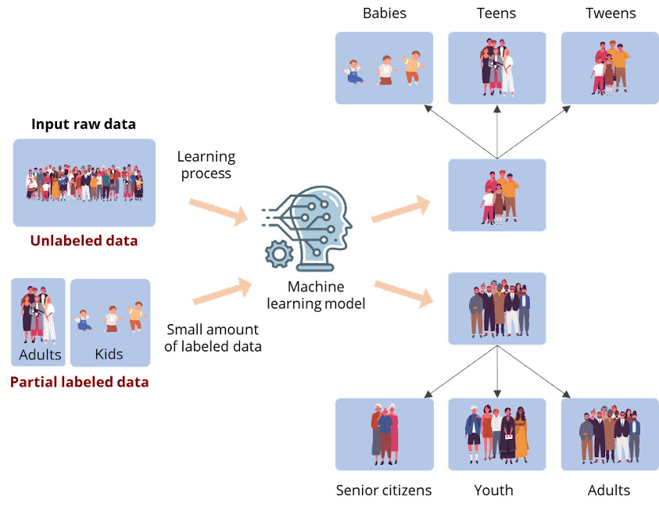
Semi-Supervised Learning: Example
This dataset contains both labeled and unlabeled data. Hence, semi-supervised learning is applied.
Notes:
Elaborate the example

Slide 22


Semi-Supervised Learning: Example
Google Photos is a popular example of semi-supervised learning.
Whenever a picture is taken, it gets stored in the Google Cloud platform or a database.
In various instances, uploaders label images. Despite Google's lack of knowledge regarding image names, its algorithm can identify them by analyzing visual features like shapes and colors.
Notes:
Instructor Notes:
One very popular example of semi-supervised learning is Google photos. So, in Google photo services, what's happening is whenever you're clicking a picture in your, let's say Google cloud or in your database, the images are getting stored. Now, in many cases, we try to tag the images by name so Google does not know the name of the images, but Google had algorithm to detect the images.

Slide 23
Reinforcement Learning
Reinforcement learning is a type of machine learning where algorithms learn from the environment by performing actions and receiving either rewards or penalties as feedback.
If the program finds the correct solution, the interpreter rewards the algorithm.
If the outcome is incorrect, the algorithm is penalized for incorrect predictions. It must reiterate until it finds a better result.
Notes:
Instructor Notes:
Reinforcement learning: In this type, the program learns from its previous errors. If the program finds the correct solution, the interpreter rewards the algorithm.
If the outcome is incorrect or not up to the mark, the algorithm must reiterate until it finds a better result.

Slide 24
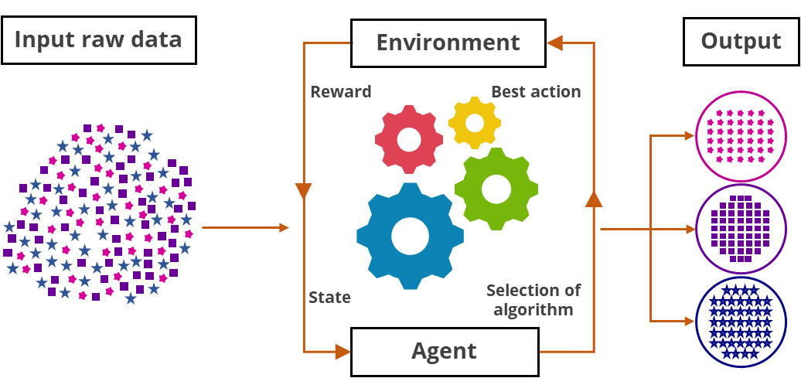
Reinforcement Learning
It involves an agent interacting with an environment, learning from rewards and states, to choose the best actions and improve performance over time.
Notes:
Instructor notes:
Reinforcement Learning Overview:
Reinforcement Learning (RL) is a type of Machine Learning where an agent learns to make decisions by performing actions and receiving feedback in the form of rewards or penalties.
The fundamental goal in RL is to develop a strategy for the agent that maximizes cumulative rewards over time.
Components of RL:
Agent: The learner or decision-maker.
Environment: Everything the agent interacts with, which provides the agent with states and rewards.
State: A snapshot of the current situation in the environment.
Action: Any decision or move made by the agent.
Reward: Feedback from the environment to assess the last action taken by the agent.

Slide 25

Reinforcement Learning: Example
This type of learning is best seen in YouTube recommendations, where a user searches for a particular song, and the program shows the list of available songs.
When the user selects a specific song, the system trains itself to remember and deliver a similar result for future searches based on user interactions, such as likes, views and shares.
Notes:
Instructor Notes:
YouTube uses reinforcement learning to personalize video recommendations by continuously learning from user interactions, such as likes, views, and shares.
The system optimizes for user engagement by suggesting videos that are likely to keep viewers on the platform longer.

Slide 26
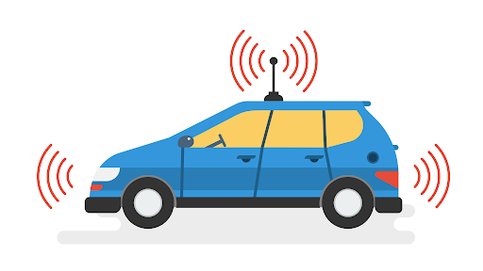



Reinforcement Learning: Examples
Examples of reinforcement learning include:
Games where players can play with bots
Self-driving cars
Autocorrect tools
Search recommendation engines
Notes:
Instructor Notes:
Examples of reinforcement learning.
Games where players can play with bots:
Description: In many modern video games, players interact with or compete against AI-controlled characters (bots), which learn and adapt using RL techniques.
How it works: These bots learn from each interaction with human players, improving their strategies over time to provide a challenging and engaging experience.
Example: Games like Dota 2 and StarCraft II where AI bots have been trained to play at or above the level of professional human players.
Self-driving cars:
Description: One of the most advanced applications of RL is in developing autonomous vehicles.
How it works: RL is used to train the driving algorithms that control these vehicles, allowing them to learn from vast amounts of driving data and real-world interactions.
Example: Companies like Tesla and Waymo use RL to improve their autonomous driving systems, learning optimal maneuvers and decision-making in real-time traffic conditions.
Autocorrect tools:
Description: Autocorrect features in smartphones and word processing software use RL to improve the accuracy of text input.
How it works: By learning from corrections made by users over time, these tools adapt and improve their suggestions for correcting spelling and grammar errors.
Example: Keyboard apps like SwiftKey and Gboard that adapt to the user's writing style and commonly used words.
Search recommendation engines:
Description: Search engines and online recommendation systems use RL to enhance the relevance of the results and suggestions they provide to users.
How it works: These systems learn from user interactions (clicks, time spent on a page, likes, etc.) to continually refine and improve the suggestions.
Example: Google Search and YouTube recommendations, where RL helps to tailor search results and video suggestions based on user behavior and preferences.

Slide 27
Introduction to Python Packages for Machine Learning
Notes:
Introduction to Python Packages for Machine Learning.

Slide 28



Python Libraries Used in Machine Learning
Some Python libraries used in machine learning include:
NumPy is a powerful library for numerical computing in Python.
Matplotlib performs data visualization and graphical plotting.
Pandas is a versatile data manipulation library in Python, offering data structures like DataFrames.
Notes:
Instructor Notes:
Some Python libraries used in machine learning are: NumPy, Pandas, Matplotlib, SciPy, SciKit-learn
NumPy and pandas help manage the preparation, loading and manipulation of data.
Matplotlib is used for the visualization of data.

Slide 29


Python Libraries Used in Machine Learning
Some Python libraries used in machine learning are:
SciPy solves mathematical equations and processes algorithms.
Scikit-learn offers efficient versions of common algorithms, facilitating the development of machine learning models.
Notes:
Instructor Notes:
SciPy is useful in solving mathematical equations and algorithms.
SciKit learn, provides efficient versions of common algorithms that help develop Ml models.

Slide 30
Machine learning refers to a machine's ability to learn from data and replicate human behavior.
AI includes machine learning and deep learning, each with unique capabilities for simulating intelligence.
There are four main types of machine learning: supervised learning, unsupervised learning, semi-supervised learning, and reinforcement learning.
Python packages are folders with modules that organize code for easy reuse and maintenance, improving development efficiency.

Slide 32
Which of the following best describes machine learning?
1
A subset of artificial intelligence (AI) that assists systems to learn and improve automatically from experience without being explicitly programmed.
A method of programming where developers manually define a set of rules and instructions.
The process of creating a set of fixed logic that a program will follow.
A technique used only for image and speech recognition tasks.

Slide 33
Which of the following best describes machine learning?
1
A subset of artificial intelligence (AI) that assists systems to learn and improve automatically from experience without being explicitly programmed.
A method of programming where developers manually define a set of rules and instructions.
The process of creating a set of fixed logic that a program will follow.
A technique used only for image and speech recognition tasks.
A
Machine learning is a subset of AI that enables systems to learn and improve automatically from experience without explicit programming.

Slide 34
Which example illustrates the use of machine learning to enhance customer experience in an e-commerce company?
2
ABC Inc. using predefined rules for transaction processing.
ABC Inc. using manual review to detect fraudulent transactions.
ABC Inc. using machine learning algorithms to detect real-time fraudulent transactions and predict customer behavior.
ABC Inc. using machine learning solely for inventory management.

Slide 35
Which example illustrates the use of machine learning to enhance customer experience in an e-commerce company?
2
ABC Inc. using predefined rules for transaction processing.
ABC Inc. using manual review to detect fraudulent transactions.
ABC Inc. using machine learning algorithms to detect real-time fraudulent transactions and predict customer behavior.
ABC Inc. using machine learning solely for inventory management.
C
ABC Inc. uses machine learning to detect fraudulent transactions in real-time and predict customer behavior to enhance the recommendation engine and customer experience.

Slide 36
What distinguishes deep learning (DL) from machine learning (ML) and artificial intelligence (AI)?
3
Deep Learning is a subset of AI focused on learning from data.
Deep Learning uses neural networks with multiple layers for complex pattern recognition.
Deep Learning encompasses the simulation of human intelligence in machines.
Deep Learning involves manually defined rules and instructions

Slide 37
What distinguishes deep learning (DL) from machine learning (ML) and artificial intelligence (AI)?
3
Deep Learning is a subset of AI focused on learning from data.
Deep Learning uses neural networks with multiple layers for complex pattern recognition.
Deep Learning encompasses the simulation of human intelligence in machines.
Deep Learning involves manually defined rules and instructions
B
Deep learning is a subset of ML that uses neural networks with multiple layers for complex pattern recognition, such as recognizing patterns in images, speech, and text.

Slide 38
Thank You

